Slide 1
Junior Unit Initiative Program
October 2020

Slide 2

City of Napa Environment
High housing costs
Growth limited by voter-approved agricultural preserve
Low vacancy rate
Program launched in 2018 post-wildfires & post recession
State of California & local initiatives to encourage ADUs

Slide 3
City of Napa Junior Unit Initiative Program
Pilot program created by City
Included lots of “carrots”
Funded with City’s General Funds
Primary purpose = expand rental housing stock
Other benefits include
Source of income for homeowners
Increase social connections
Allows community to be part of housing solution

Slide 4
Focus of Program:
Cost efficient ADUs
Junior Units
Carved out of existing room in house
Provides private bathroom or access to shared bathroom
Separate entrance
Conversion ADUs
Converts accessory structure into ADU
Most popular = garage conversion

Slide 5
Financing Structure for Junior Units
Up to $50K forgivable loan
0% interest
Forgiven at 5% per year if renting out unit
Fully forgiven after 20 years
Due in one year if decide to stop participation
Up to $5K grant for ADA improvements
Up to $2K grant if design services needed
Up to $3K grant if engineering services needed

Slide 6
Financing Structure for Conversion ADUs
Up to $75K
$50K forgivable loan – same terms as for junior unit
$25K 0% deferred loan due in 20 years
Same grants as for junior units except up to $4K grant if design services required

Slide 7


Program Requirements
Property eligibility criteria:
Located within Napa city limits
Single family home
Owner occupied
Must create a junior unit or unit in existing accessory structure
Includes garage conversion
Must create a rental unit
Either primary or junior unit/ADU
Rented to non-family member

Slide 8
Rental Unit Requirements
Tenant must be low-income
Rent must be affordable
Household Size | Maximum Household Income
1 | $60,100
2 | $68,650
3 | $77,250
4 | $85,800
5 | $92,700
6 | $99,550
Unit Size | Maximum Affordable Rent
Studio | $1,139
1-bedroom | $1,301
2-bedroom | $1,463
3-bedroom | $1,625
4-bedroom | $1,755

Slide 9
Program Encourages
Use of professional property management
Discounted rates available
Use of Napa Valley Community Housing Home Sharing Match-up Program
Non-Profit
Free to participants
Pre-screened tenants
Mediation services

Slide 10

Program Services Include
Project management
Scope of Work
Finding a contractor
Overseeing construction

Slide 11
Challenges
Non-profit administrator out-of-business
Increased construction costs
Lack of contractors
Lack of architects (now allow designers)
Hiccups in initial building approval process
Customers sometimes slow to commit
Original program did not include converted ADUs or garage conversions

Slide 12
To Date
Program budget = $1.38 M
Pending additional State financing

Slide 13
Lessons Learned
Listen
Be flexible
Be patient

Slide 14
Municipal Funding Options
Local funding
Most flexible
State funding
Federal funding
CDBG
HOME
Other ways to encourage ADUs
Developer in-lieu
Non-profit partnerships
Explore procedures, zoning, & fee structures

Slide 15
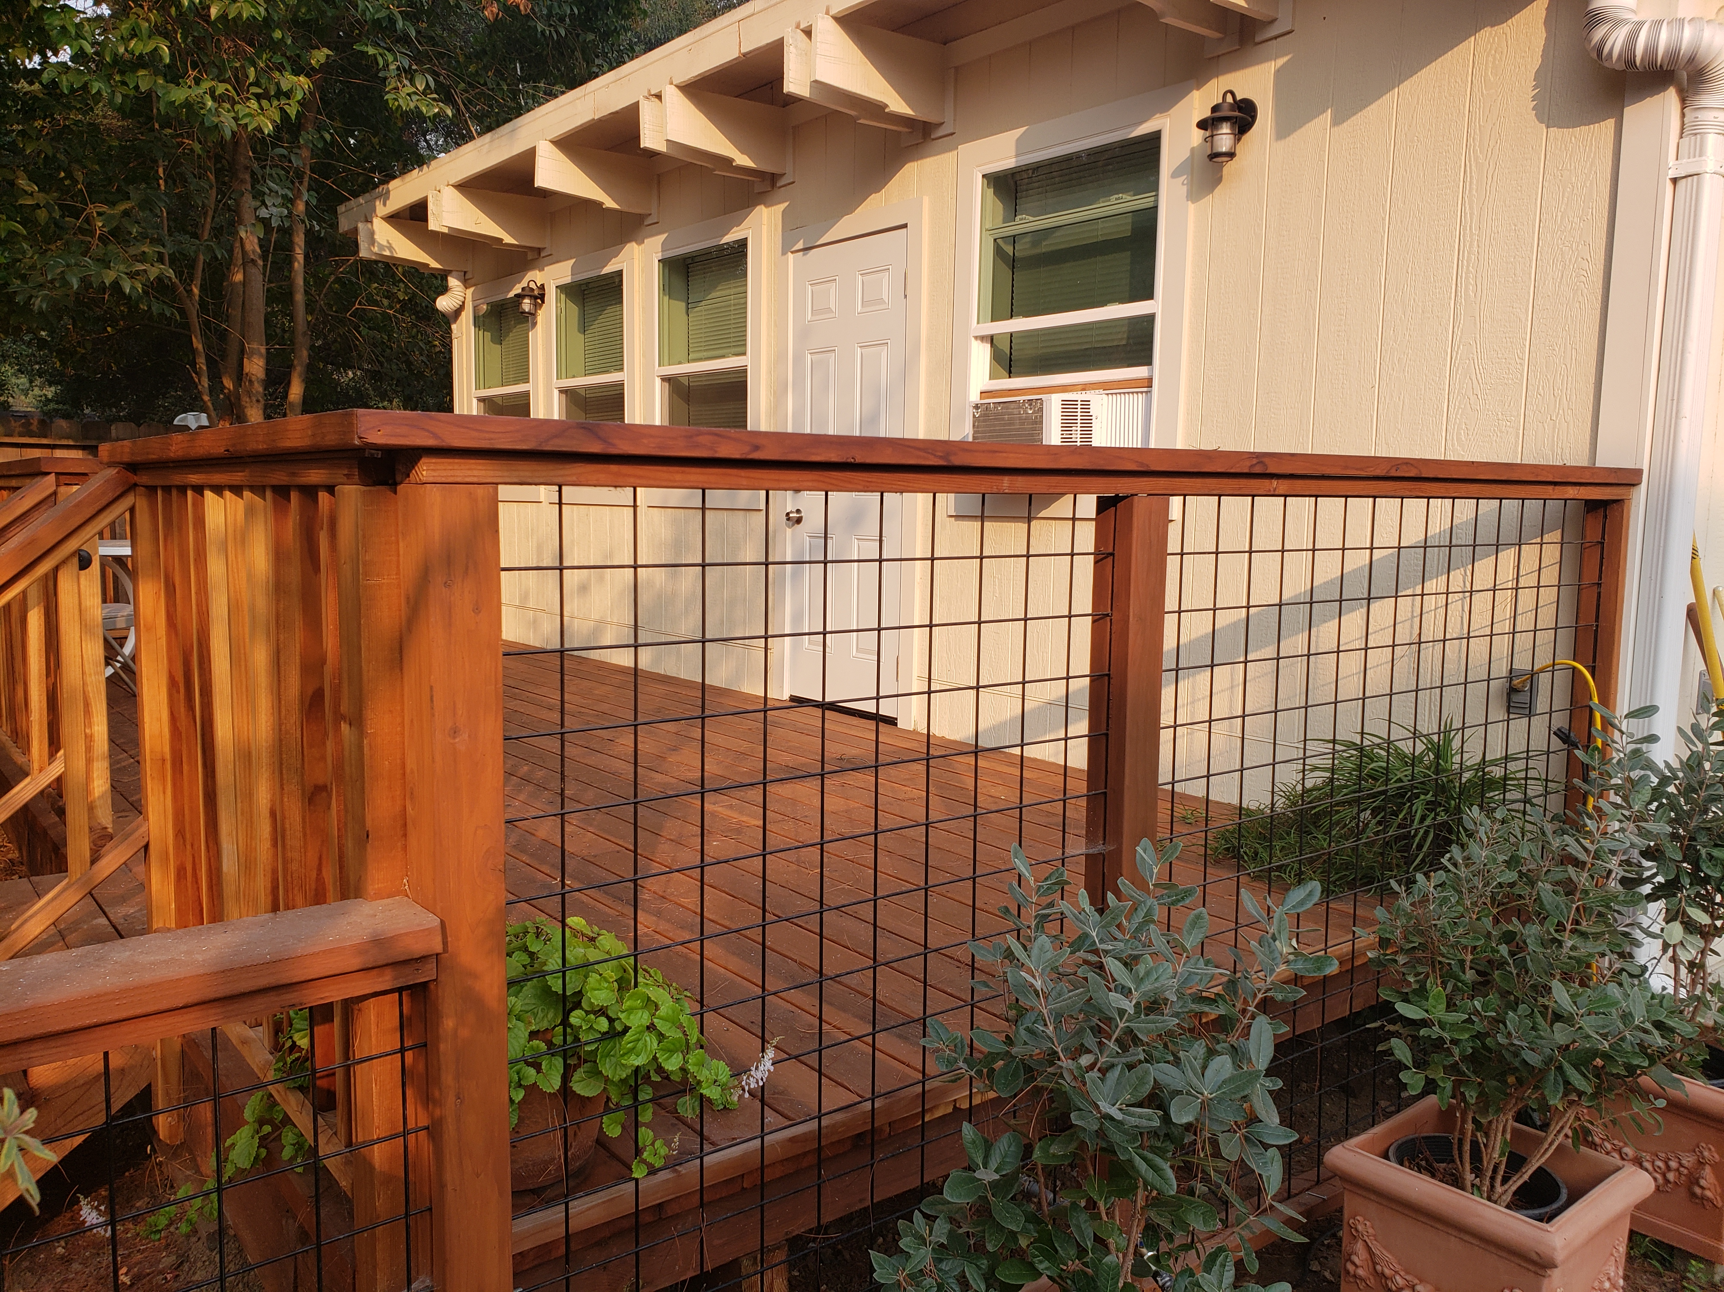
First Conversion ADU

Slide 16
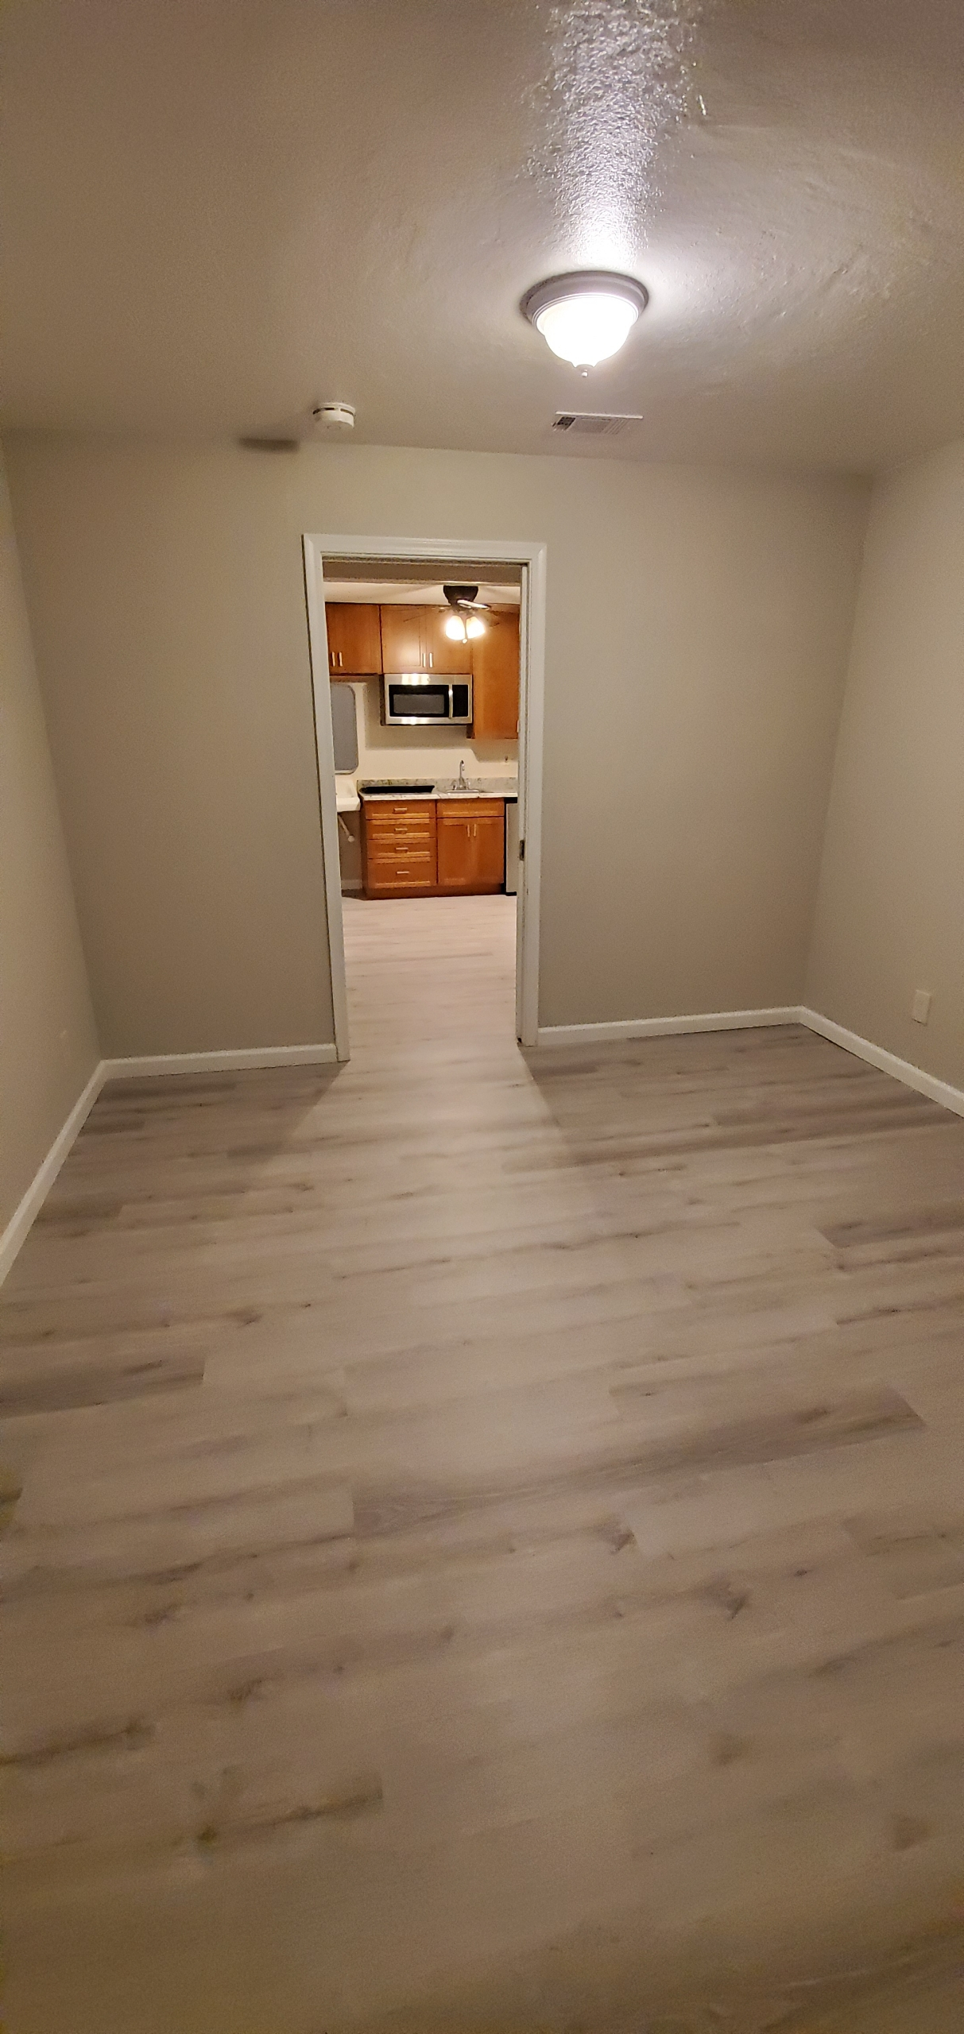
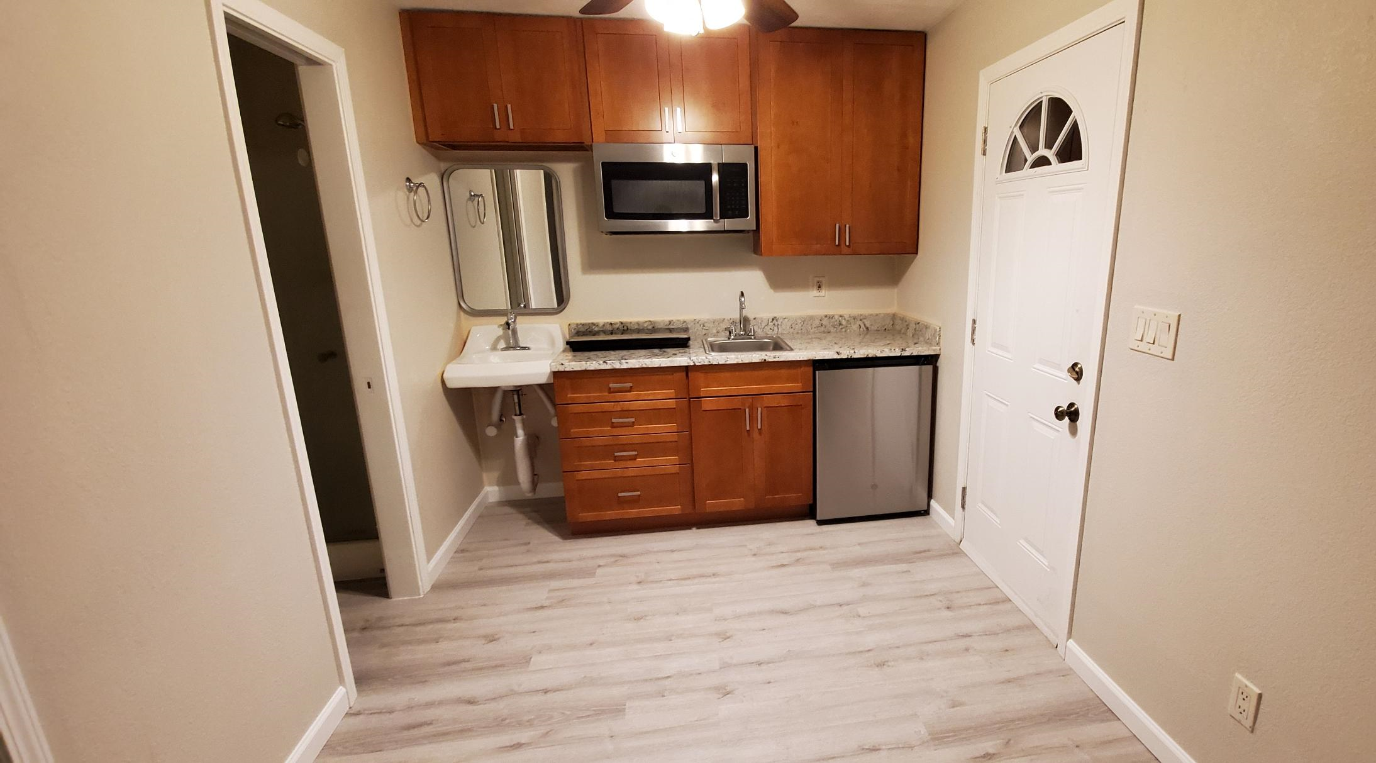
Completed Junior Unit

Slide 17
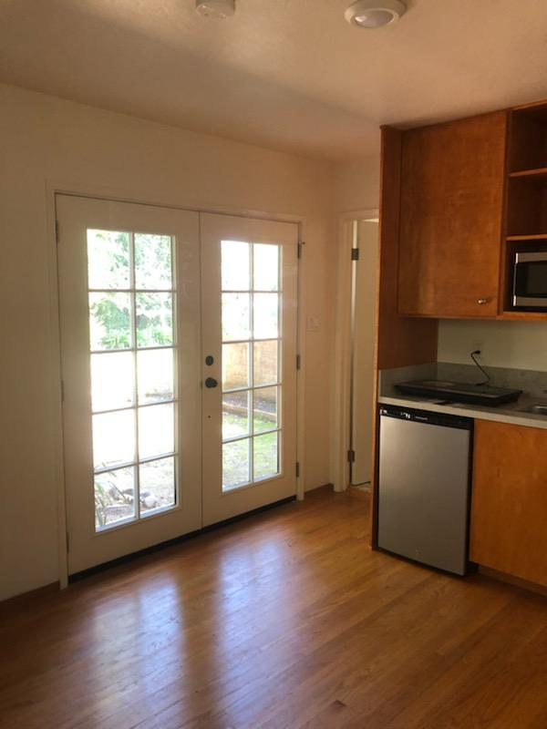
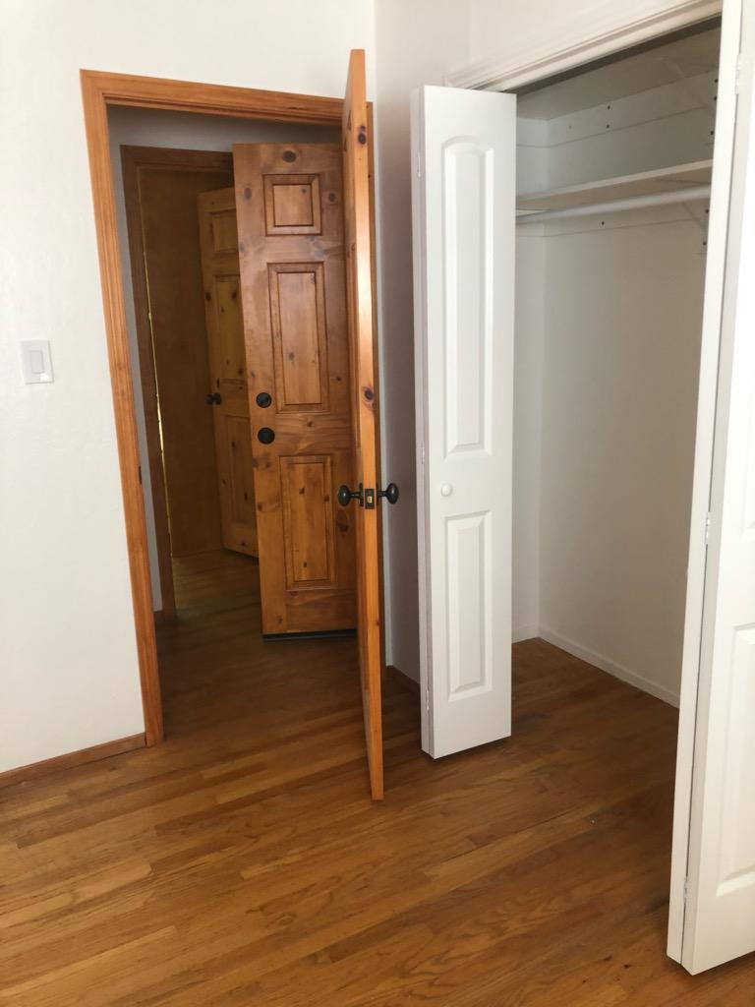
Another Completed Junior Unit

Slide 18

For more information:
Visit our website at www.cityofnapa.org
or e-mail
lferrell@cityofnapa.org

