Slide 1
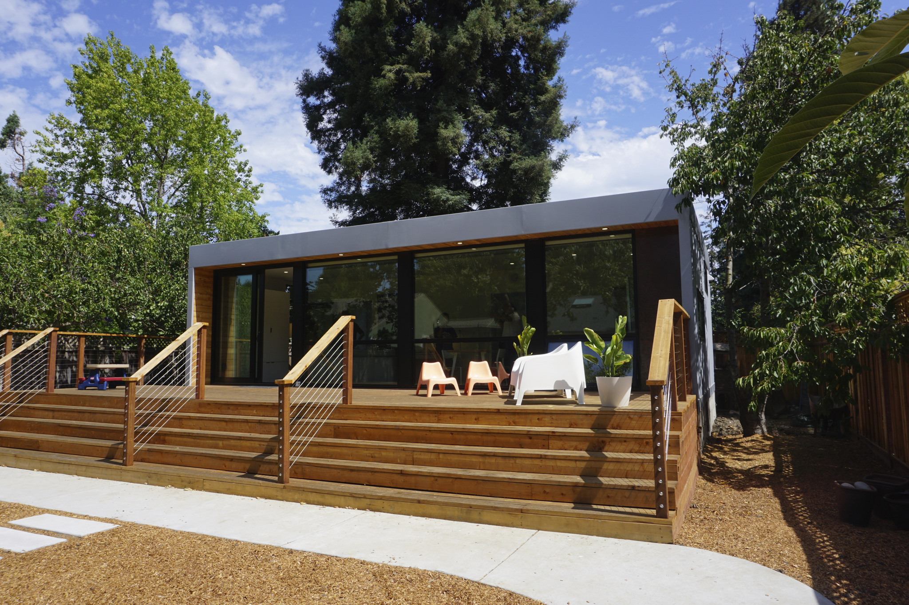


SMALL HOMES, BIG IMPACT
ADU Program
DO NOT COPY
Financing & Access to Capital for Low/Fixed Income Homeowners
Housing Trust Silicon Valley
adu@housingtrustsv.org
Disclaimer
Equal Housing Opportunity. Housing Trust is a California Community Lender licensed by the Department of Business Oversight. State of California CFL Lender License #6053356. NMLS License #287840.

Slide 2
Who We Are: Housing Trust Silicon Valley
We are a Community Development Financial Institution (CDFI) working in 13-counties in the S.F. Bay area and the region’s highest-volume nonprofit housing lender
We help everyone – from those experiencing homelessness to developers of affordable rental housing to first-time homebuyers and individual homeowners - with their affordable housing needs
We became the first nonprofit housing lender in the country with a Standard & Poor’s credit rating (AA-)
DO NOT COPY
Unauthorized use or reproduction of logos or materials is not allowed without express written permission.

Slide 3
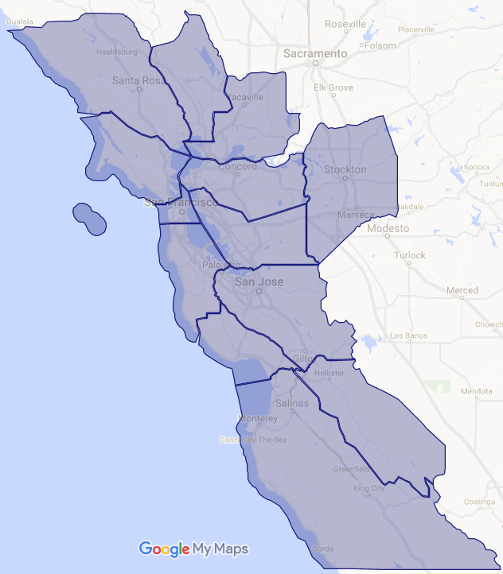
Our Impact to Date
San Francisco
Since 2000….
$335 million invested
Over 20,761 affordable homes produced
38,000+ people helped
Oakland
San Jose
DO NOT COPY
Unauthorized use or reproduction of logos or materials is not allowed without express written permission.
Monterey
Housing Trust lends in 13 counties in the greater Bay Area that have one thing in common – a critical need for affordable housing & more capital to support its development
S&P Global Ratings
AA-

Slide 4
Purpose of Small Homes Big Impact ADU Construction Loan Program
The purpose of our ADU Program is to reduce barriers for homeowners developing ADUs by providing education, resources and financing in the form of a Construction Loan Product:
  Quarterly, Live Educational Workshops – replaced with online Webinars
  ADU Resources - List of Preferred vendors
  Financial Assistance - Construction Loan
DO NOT COPY
Unauthorized use or reproduction of logos or materials is not allowed without express written permission.

Slide 5
Overview: Construction Loan Terms
Maximum Loan Amount | Up to $200,000
Type of Loan | Second Mortgage / Deed of Trust
Loan Term | 36-month term
Amortization Rate | 20-year amortization
Interest Rate | Year 1: Interest only payments Years 2-3: Principal and Interest
CLTV (Combined Loan to Value) | 97%
DO NOT COPY
Unauthorized use or reproduction of logos or materials is not allowed without express written permission.
Affordability Restriction | Tenant income restriction up to 120% AMI ($118,920) Tenant may utilize up to 30% of income towards rent
Notes:
Rents caps
Studio: 1,982
1 Bedroom: $2,266
2 Bedroom: $2,549

Slide 6
Internal Challenges/Solutions to Launch
Created an Internal Working Group to address gaps
Setup the right partner collaborations
Product must be designed for the homeowners needs, not readymade product
DO NOT COPY
Unauthorized use or reproduction of logos or materials is not allowed without express written permission.

Slide 7
Benefits of Housing Trust ADU Construction Loan Program
Be part of the solution in Bay Area housing crisis by creating an affordable unit in your own backyard!
Create an extra source of income by renting out your ADU
With the tenant affordability feature built into the loan, the construction loan provides landlord experience & rental income for 2 years which allows you to refinance the loan at the end of 3 years with a conventional lender
DO NOT COPY
Unauthorized use or reproduction of logos or materials is not allowed without express written permission.

Slide 8
Thank you!
Sonya Singha
408-703-3837 x 308
sonya@housingtrustsv.org
Housing Trust Silicon Valley
adu@housingtrustsv.org
Disclaimer
Equal Housing Opportunity. Housing Trust is a California Community Lender licensed by the Department of Business Oversight. State of California CFL Lender License #6053356. NMLS License #287840.

